Slide 1
Nov 10

Slide 2
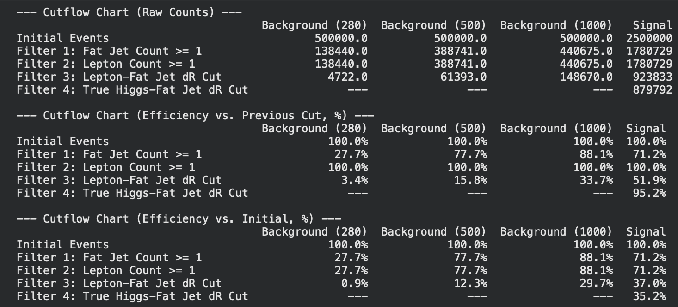
Event Weights:
--- Internal Background Weights ---
BG 280 GeV: Size=4722, Internal Weight=15.1620
BG 500 GeV: Size=61393, Internal Weight=1.1662
BG 1000 GeV: Size=148670, Internal Weight=0.4816
--- Signal vs Background Weights ---
Signal: Size=879792, Final Weight=0.6221
Background: Raw Size=214785, Final Multiplier=2.5481

Slide 3
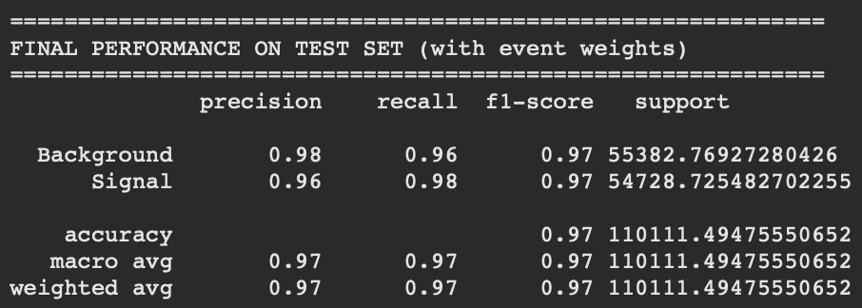
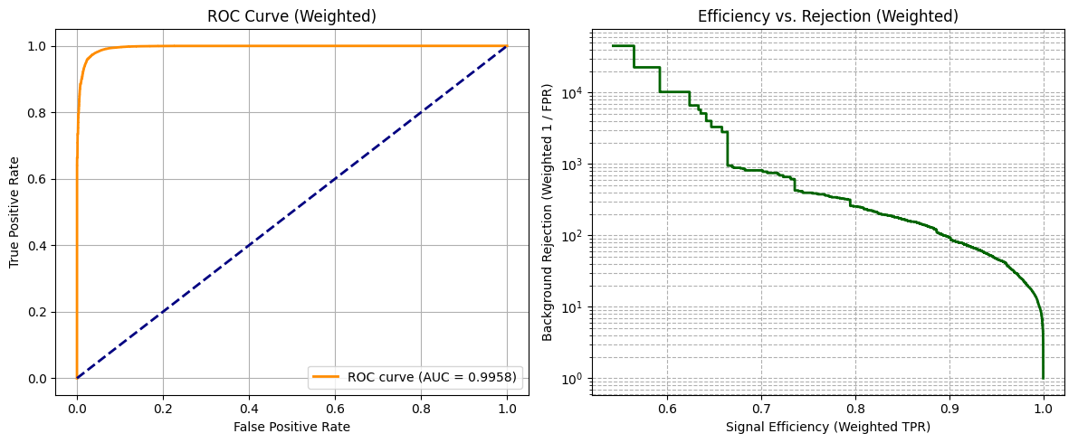
Baseline Model

Slide 4
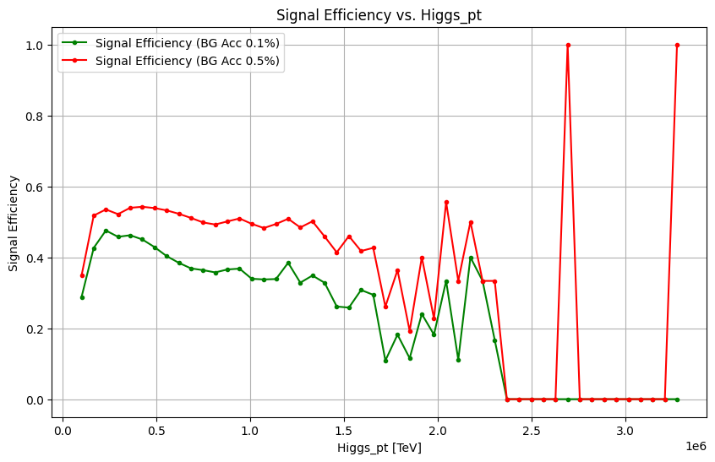
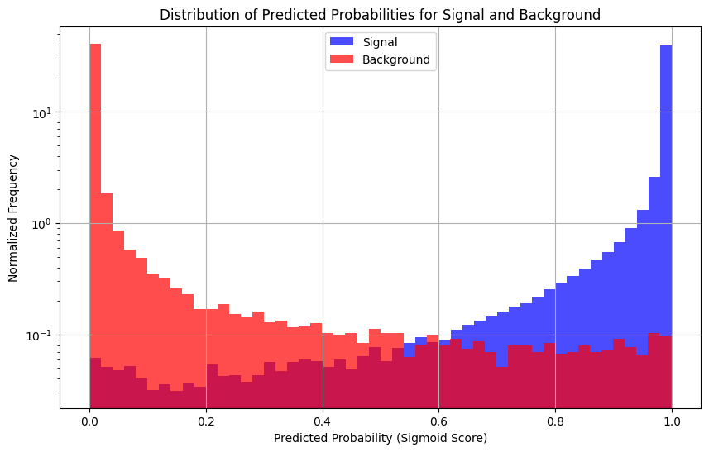
Sanity Check w/ signal eff curve

Slide 5
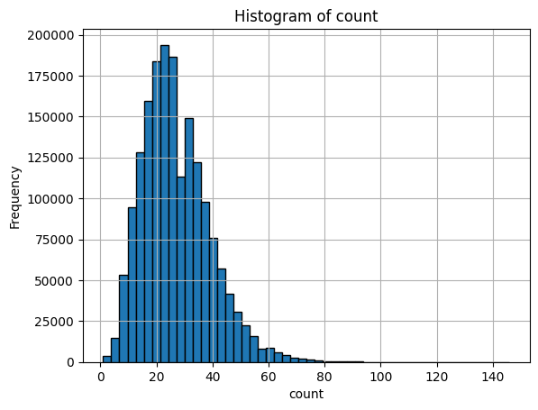
GNN Questions
Jet constituent features: relative eta, rel_phi, rel_pt, delta_r (wrt fat jet), mass?
N constituent to consider?
Model: GNN run on fat jet and then concatenate GNN output to baseline model input and run baseline DNN
nrp setup?
constituent count per fat jet

